Slide 1
Data Structures
Lecture 4
Linked List Variations + Doubly Linked List
Prantik Paul [PNP]
Lecturer
Department of Computer Science and Engineering
BRAC University

Slide 2
Singly Linked List (Problems)
Traversal
Determine where to stop
Operations near the end
Moving back in Time

Slide 3
Types of Linked List
Head Type
Connection
Structure
Category 1 | Category 2 | Category 3
Non-Dummy Headed | Singly | Linear
Dummy Headed | Doubly | Circular

Slide 4
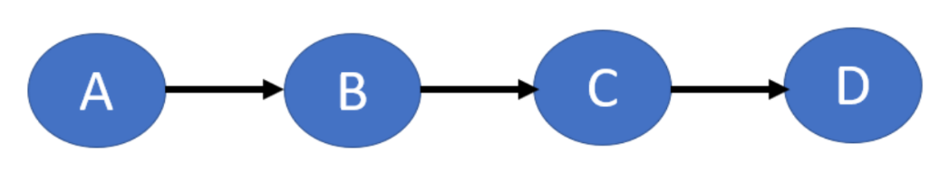
Non-Dummy Headed Singly Linear Linked List

Slide 5
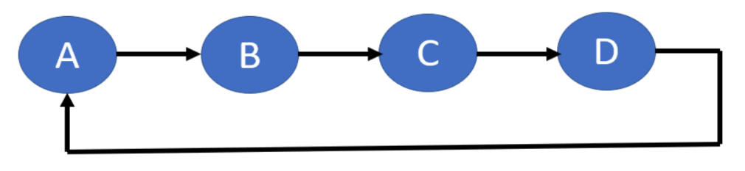
Non-Dummy Headed Singly Circular Linked List

Slide 6
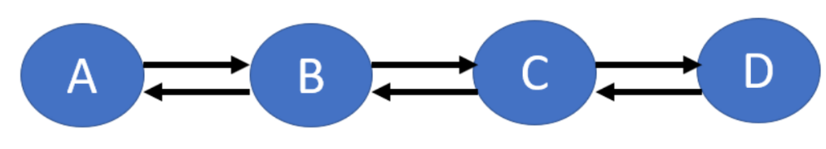
Non-Dummy Headed Doubly Linear Linked List

Slide 7
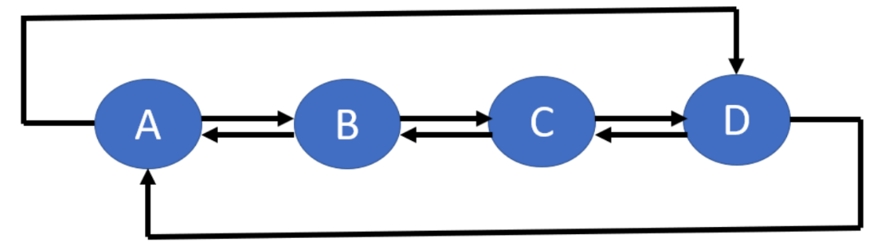
Non-Dummy Headed Doubly Circular Linked List

Slide 8
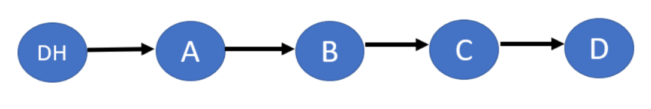
Dummy Headed Singly Linear Linked List

Slide 9
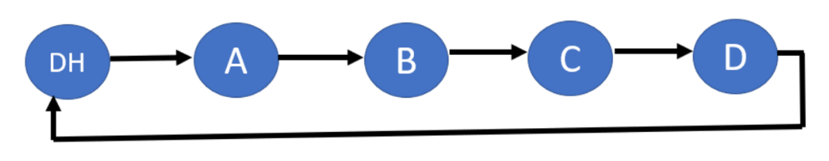
Dummy Headed Singly Circular Linked List

Slide 10
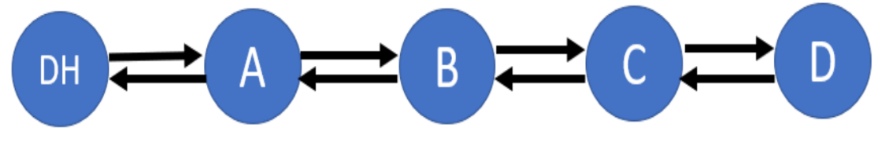
Dummy Headed Doubly Linear Linked List

Slide 11
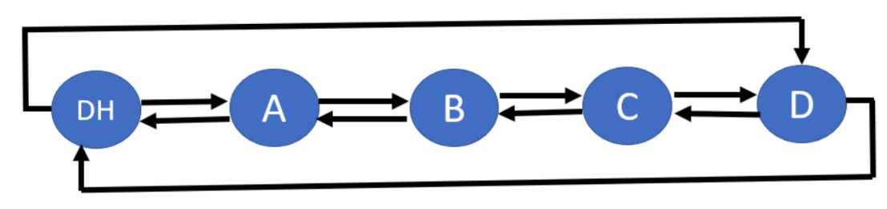
Dummy Headed Doubly Circular Linked List

Slide 12
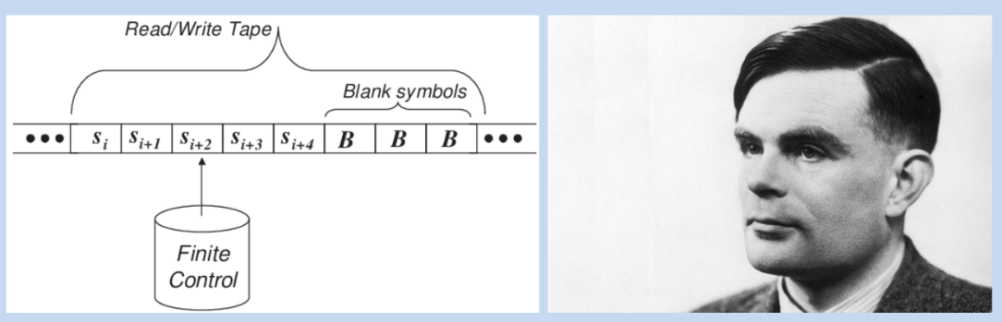
Why Doubly Linked List

Slide 13
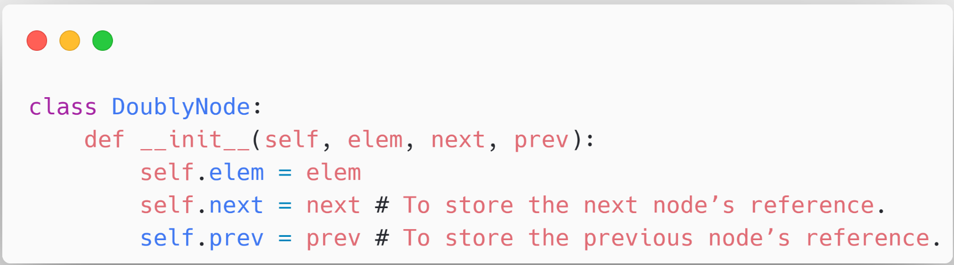
Doubly Linked List (Node Class)

Slide 14
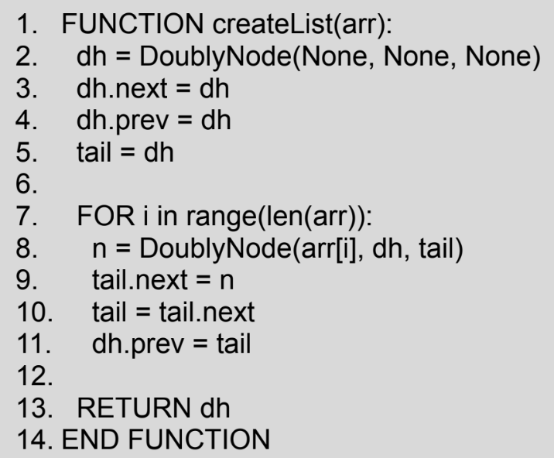
DH Doubly Linked List (Creation)

Slide 15
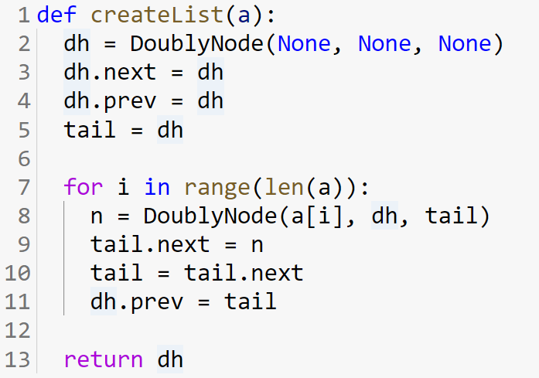
Doubly Linked List (Creation)

Slide 16
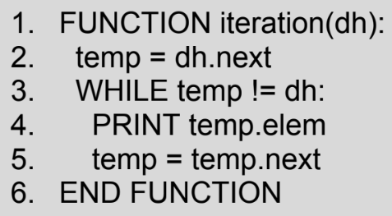
DH Doubly Linked List (Iteration)

Slide 17
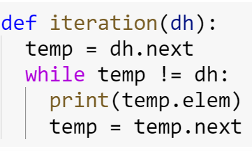
DH Doubly Linked List (Iteration)

Slide 18
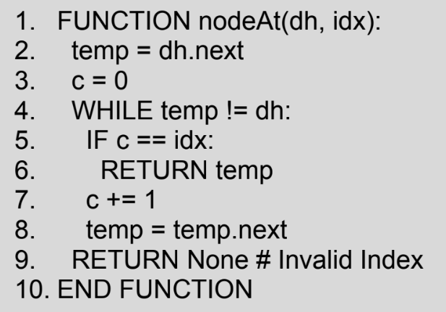
DH Doubly Linked List (GetNode)

Slide 19
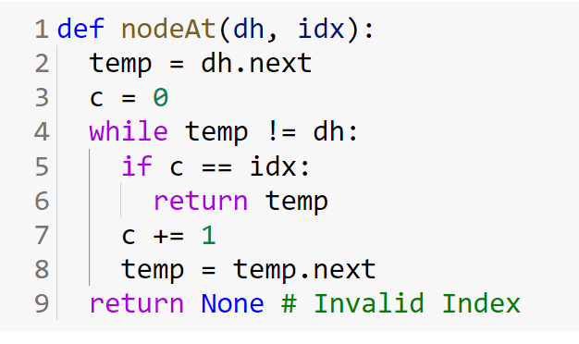
DH Doubly Linked List (GetNode)

Slide 20
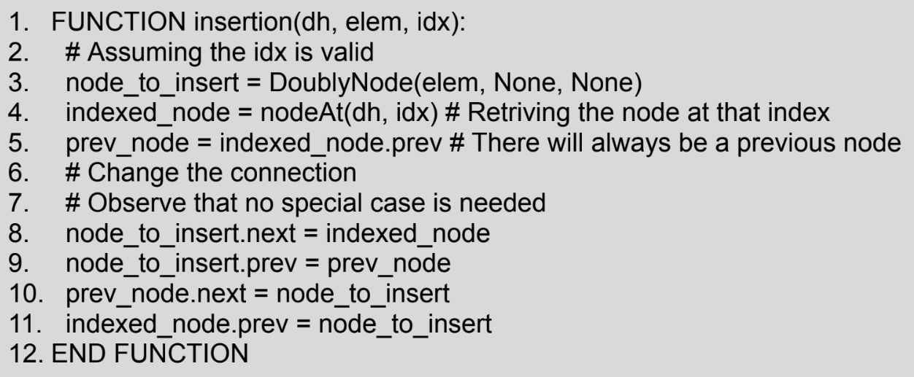
DH Doubly Linked List (Insertion)

Slide 21
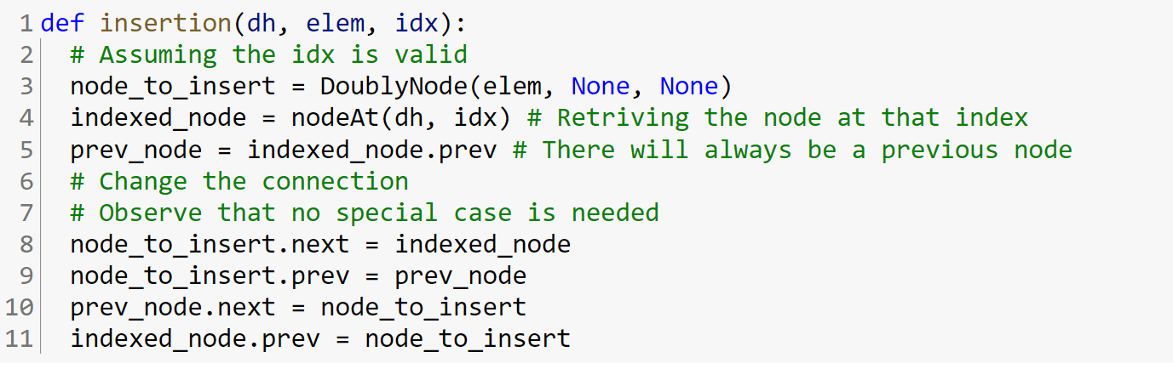
DH Doubly Linked List (Insertion)

Slide 22
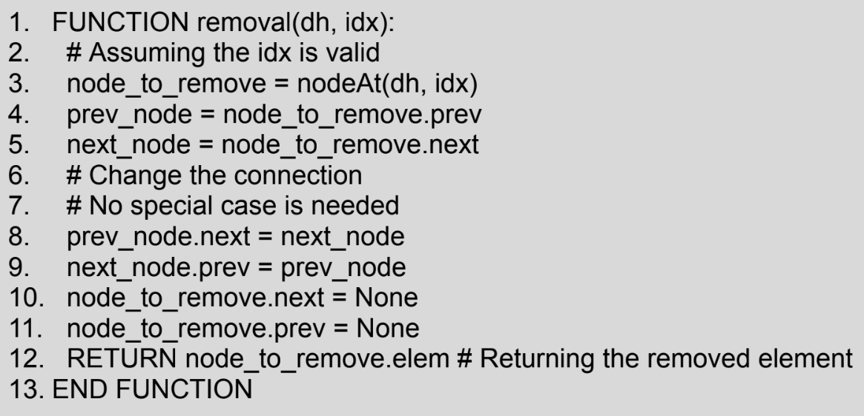
DH Doubly Linked List (Removal)

Slide 23
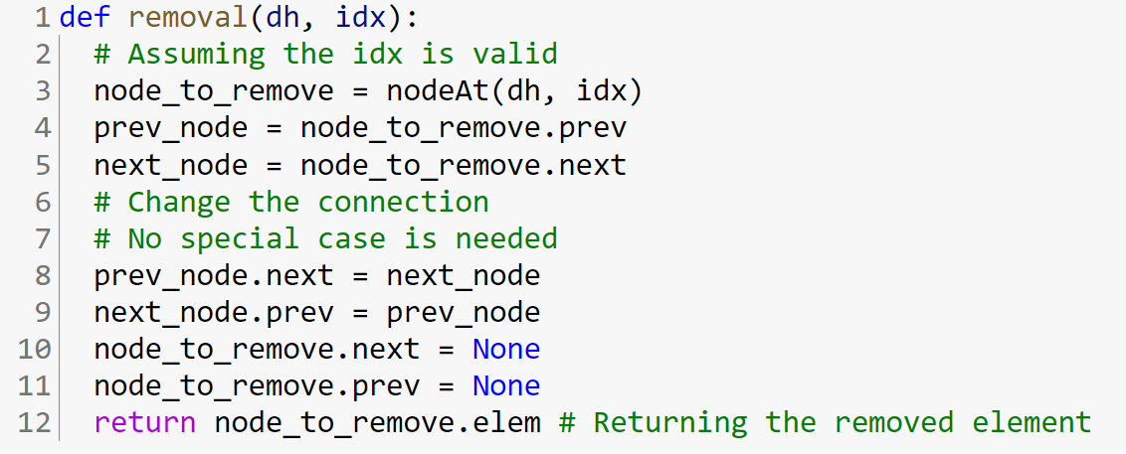
DH Doubly Linked List (Removal)

